Slide 1

Arduino Course
SERGIO ANDRES CASTAÑO GIRALDO

Slide 2
Repository
https://github.com/sergioacg/POChE

Slide 3
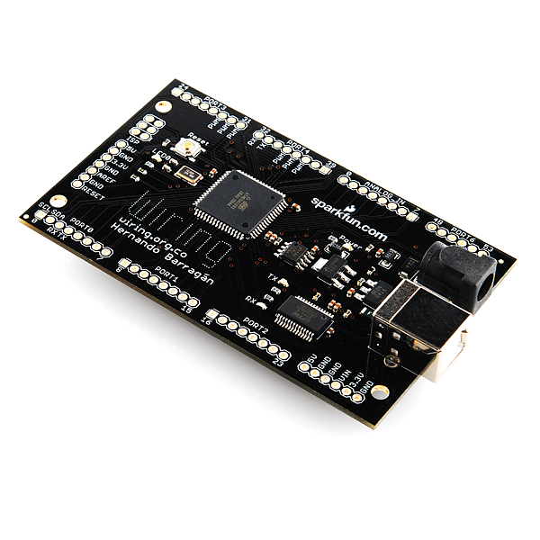


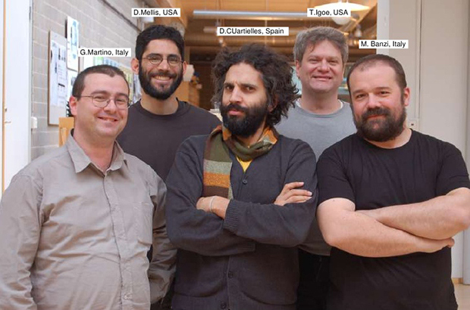
Processing
MIT
C++
HERNANDO BARRAGÁN

Slide 4
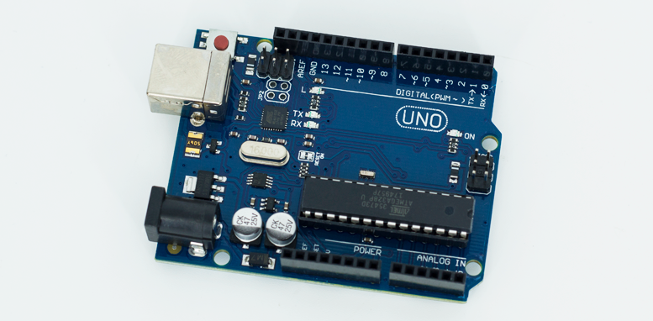
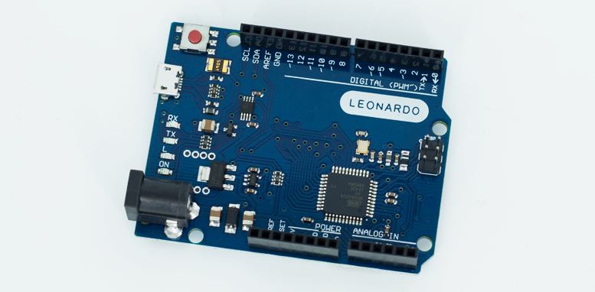
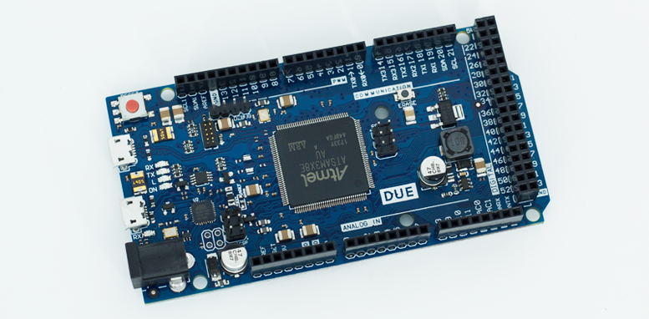
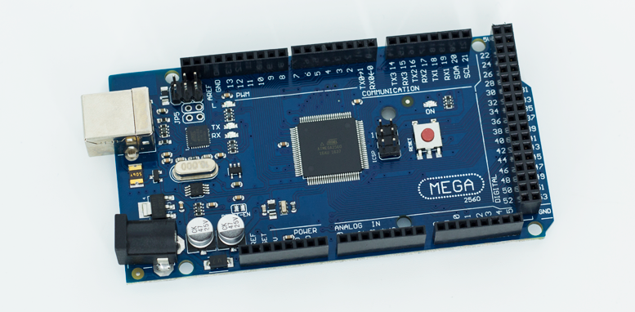
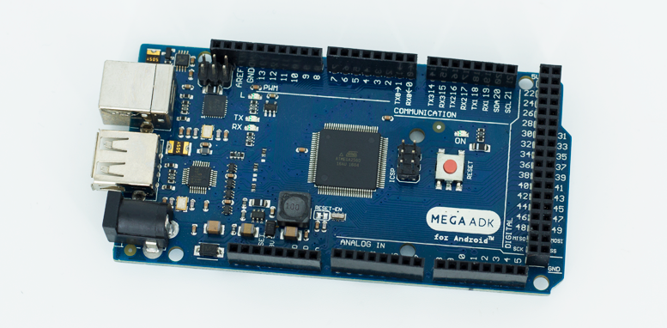
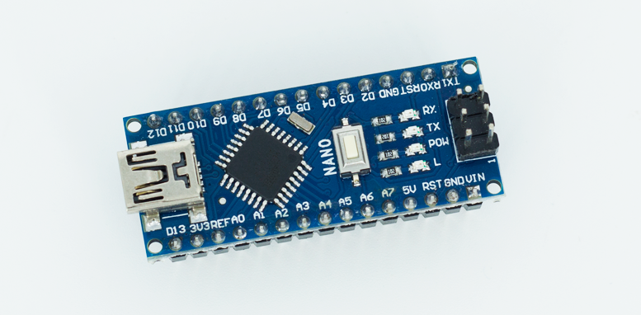

Slide 5

Wokwi
https://wokwi.com/
Wokwi is an online Electronics simulator. You can use it to simulate Arduino, ESP32, STM32, and many other popular boards, parts and sensors.

Slide 6
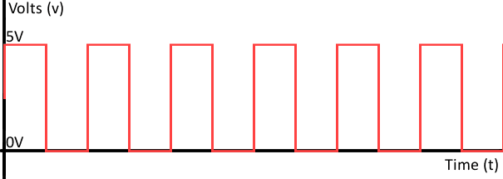
WHAT IS A DIGITAL OUTPUT?
In digital electronic circuits, a digital output is a pin on the microcontroller that can take only two states (binary).
High State – True – 5V – 3.3V – Logical 1
Low State – False – 0V – Logical 0

Slide 7
ARDUINO DIGITAL OUTPUTS
Pin 0 – 13: Digital pins that can be used as Outputs or Inputs.
Recommendation: If you wish to use PIN 0 and 1 as Outputs, it is necessary to disconnect the circuit to carry out the board programming.

Slide 8

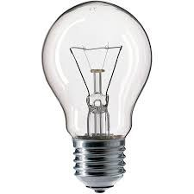
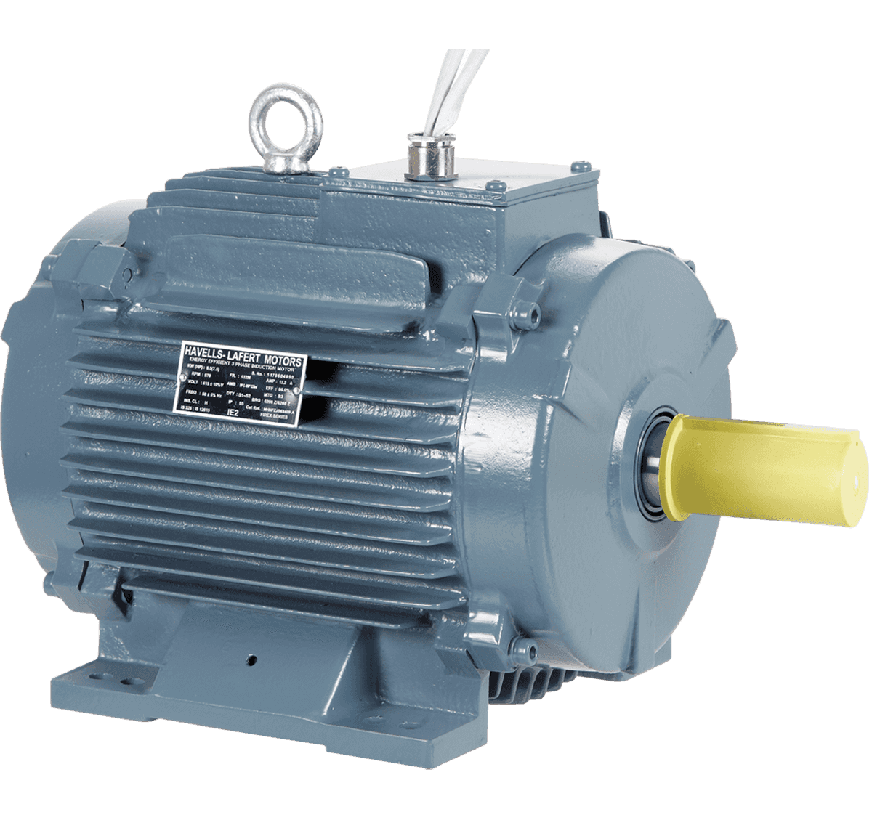


WHAT IS THE PURPOSE OF A DIGITAL OUTPUT?
It serves to interact with the real physical world. To turn on or off devices.

Slide 9
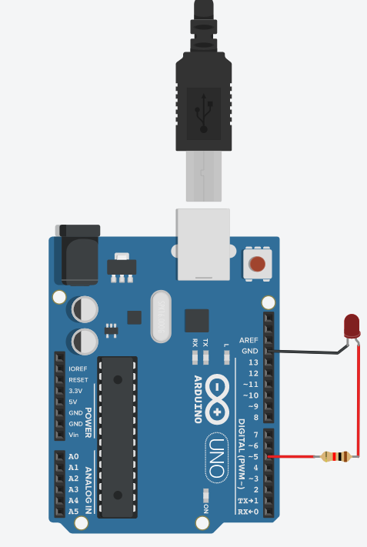
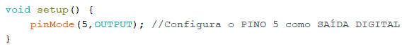
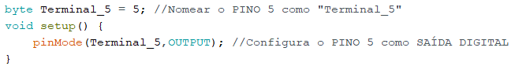
DECLARING DIGITAL OUTPUTS IN ARDUINO
We will declare PIN 5 as an Output, to connect it to an LED (Light Emitting Diode).
pinMode(Digital PIN, OUTPUT);

Slide 10
USING DIGITAL OUTPUTS IN ARDUINO
Once the digital output is configured, we can specify whether we want to activate or deactivate the digital output.
digitalWrite(Output Pin, HIGH);
digitalWrite(Output Pin, LOW);

Slide 11
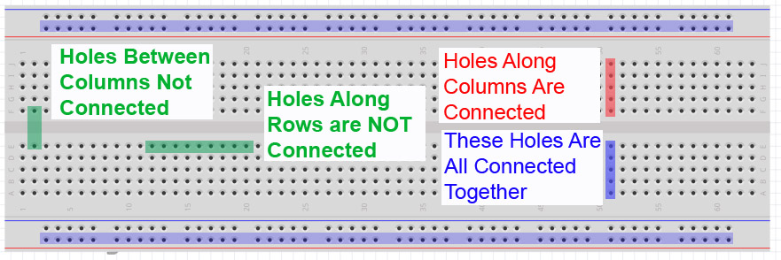
Breadboard

Slide 12

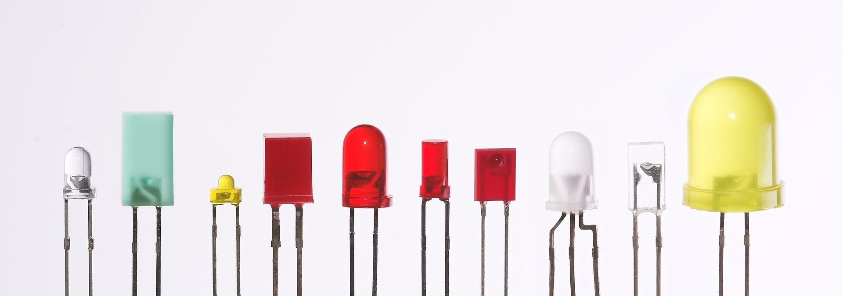
LED
The light-emitting diode, also known by the English acronym LED (Light Emitting Diode), is used for light emission in locations and instruments where its use is more convenient than that of a traditional bulb.

Slide 13
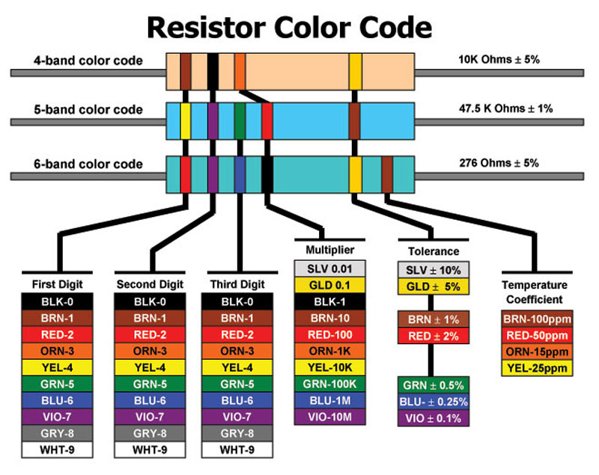
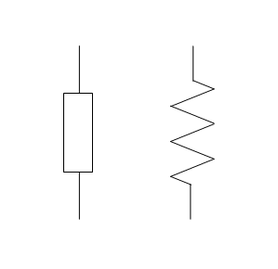
RESISTOR
Resistors are components whose purpose is to offer opposition to the flow of electric current through their material. This opposition is referred to as electrical resistance or impedance, and its unit is the ohm.

Slide 14
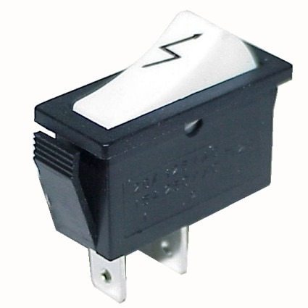
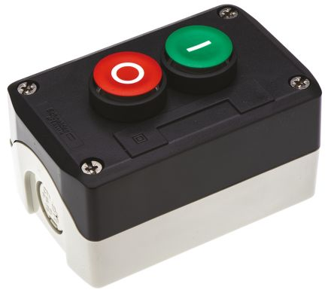
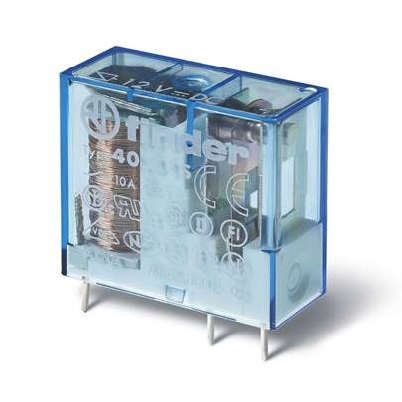
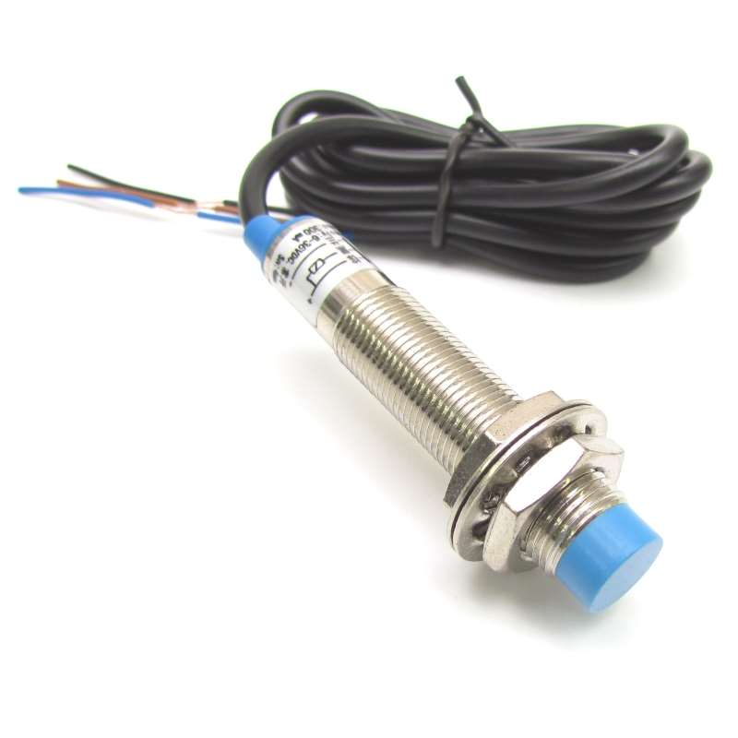
WHAT IS THE PURPOSE OF A DIGITAL INPUT?
It serves to interact with the real physical world. To read what is happening.

Slide 15
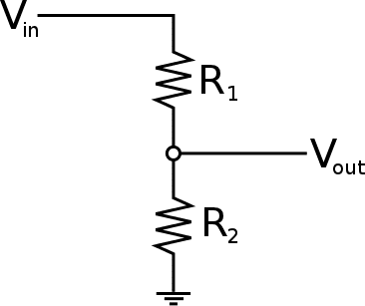
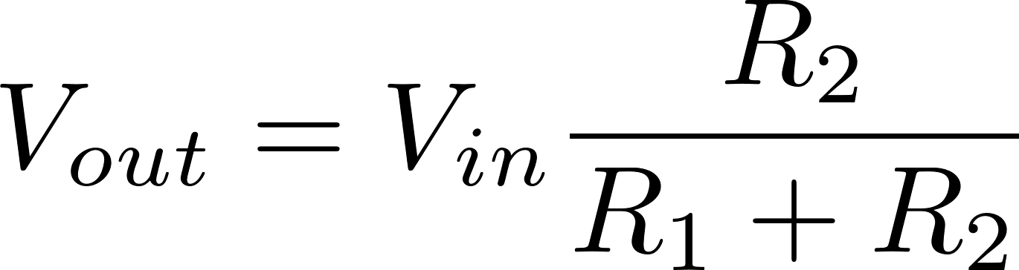
VOLTAGE OF DIGITAL INPUTS
Input voltage can only be 5V or 3.3V for the Arduino Nano.
If one has a voltage greater than 5V, a voltage divider can be used at the Arduino's input.

Slide 16
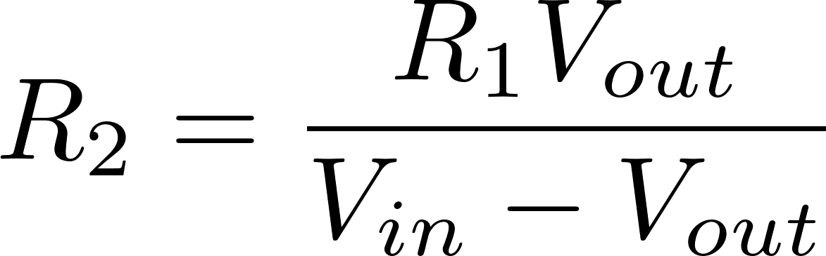
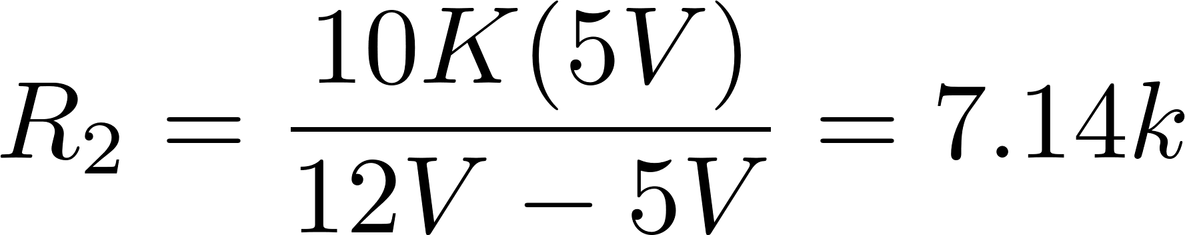
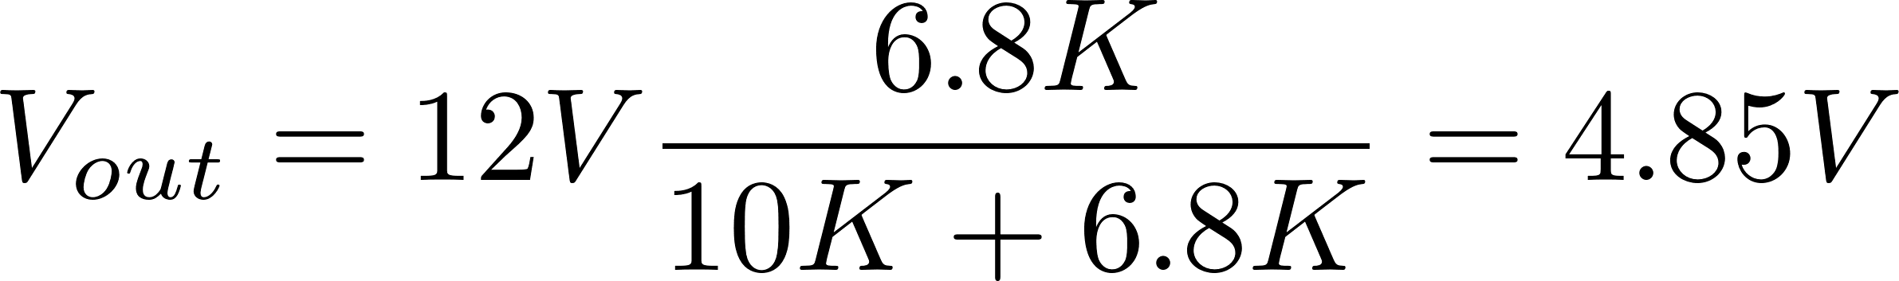
VOLTAGE OF DIGITAL INPUTS
12v
10k
6.8k

Slide 17
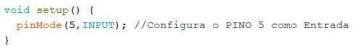
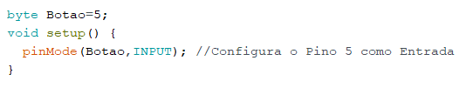
DECLARING DIGITAL INPUTS IN ARDUINO
We will declare PIN 5 as an Input.
pinMode(Digital PIN, INPUT);

Slide 18
USING DIGITAL INPUTS IN ARDUINO
Once the digital input is configured, we can read the state of the input.
Variable = digitalRead(Input Pin);

Slide 19
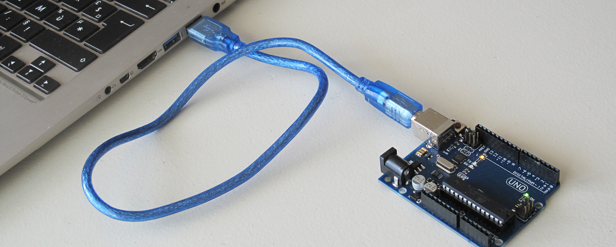
SERIAL COMMUNICATION

Slide 20
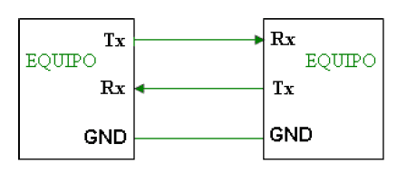
SERIAL COMMUNICATION
Data Reception Line (RX)
Data Transmission Line (TX)
Common Line (GND)

Slide 21
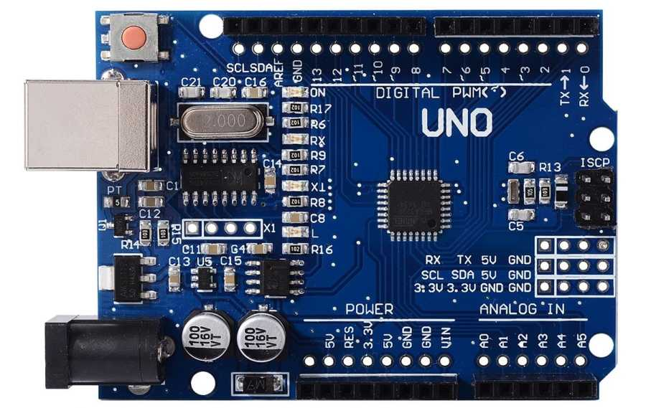
SERIAL COMMUNICATION
These lines can be easily found on our Arduino board.
Arduino UNO and Mini Pro: Pins 0 (RX) and 1 (TX)

Slide 22
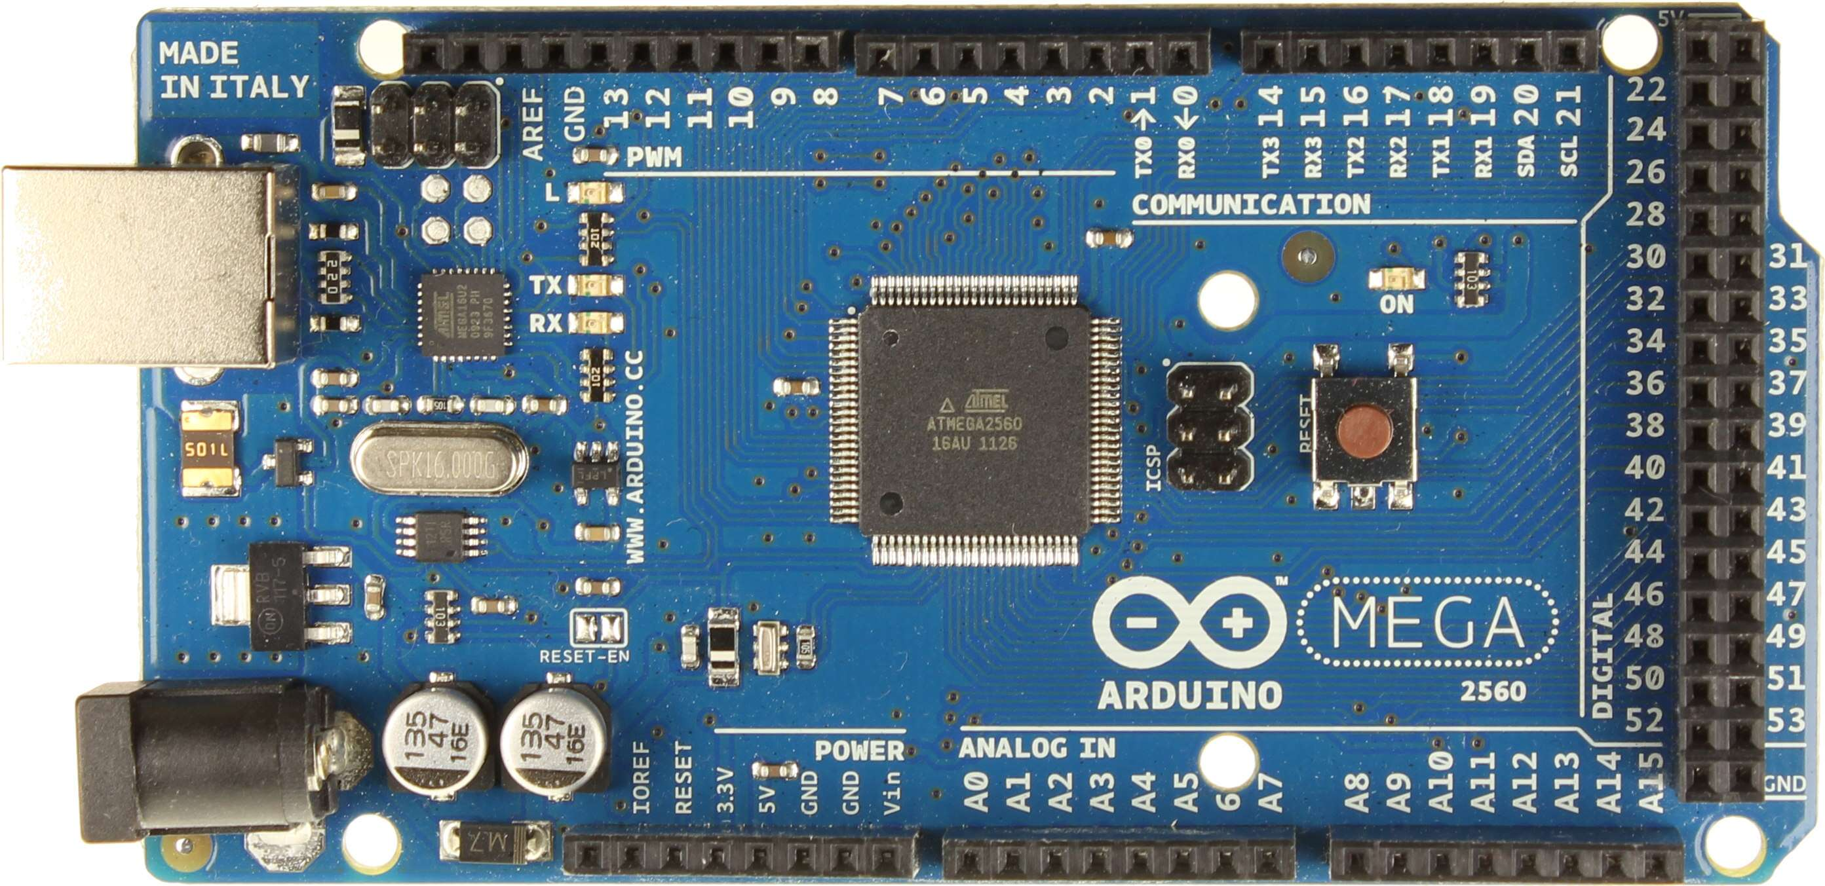
SERIAL COMMUNICATION
These lines can be easily found on our Arduino board.
Arduino Mega and Arduino Due: They have four serial ports.
i) Serial Port 0: Pins 0 (RX) and 1 (TX)
ii) Serial Port 1: Pins 19 (RX) and 18 (TX)
iii) Serial Port 2: Pins 17 (RX) and 16 (TX)
iv) Serial Port 3: Pins 15 (RX) and 14 (TX)

Slide 23
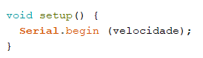
Steps for Working with Serial Communication in Arduino
Configure the Serial Communication
Where the speed can have the following values: 300, 600, 1200, 2400, 4800, 9600, 14400, 19200, 28800, 38400, 57600, or 115200.

Slide 24
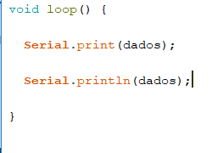
Steps for Working with Serial Communication in Arduino
print or display data on the Serial Monitor

Slide 25
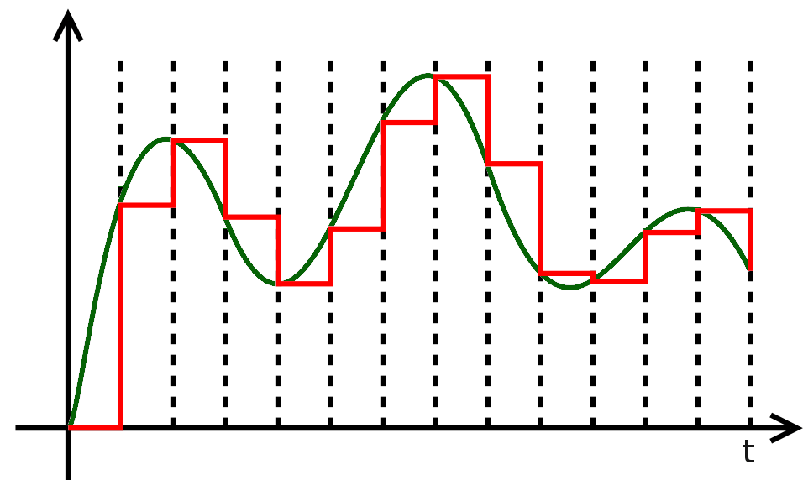
ANALOG INPUTS IN ARDUINO
All physical signals captured by our senses, as well as any variable existing in the environment (temperature, speed, weight, flow, etc.), are analog signals, i.e., signals that vary over time.
Discrete approximation
Analog signal
Notes:
O Arduino tem a capacidade de ler sinais analógicos, fazendo aproximações discretas através de pequenos retângulos digitais, como foi observado na figura anterior, onde podemos ver facilmente que quanto menor são os retângulos, mais próxima a aproximação digital será em relação ao sinal analógico

Slide 26
ANALOG TO DIGITAL CONVERTER
The Arduino ADC is responsible for analog-to-digital conversion and has a 10-bit resolution.
BOARD | OPERATING VOLTAGE | USABLE PINS | MAX RESOLUTION
Uno | 5 Volts | A0 to A5 | 10 bits
Mini, Nano | 5 Volts | A0 to A7 | 10 bits
Mega, Mega2560, MegaADK | 5 Volts | A0 to A14 | 10 bits
Micro | 5 Volts | A0 to A11* | 10 bits
Leonardo | 5 Volts | A0 to A11* | 10 bits
Zero | 3.3 Volts | A0 to A5 | 12 bits**
Due | 3.3 Volts | A0 to A11 | 12 bits**
MKR Family boards | 3.3 Volts | A0 to A6 | 12 bits**

Slide 27
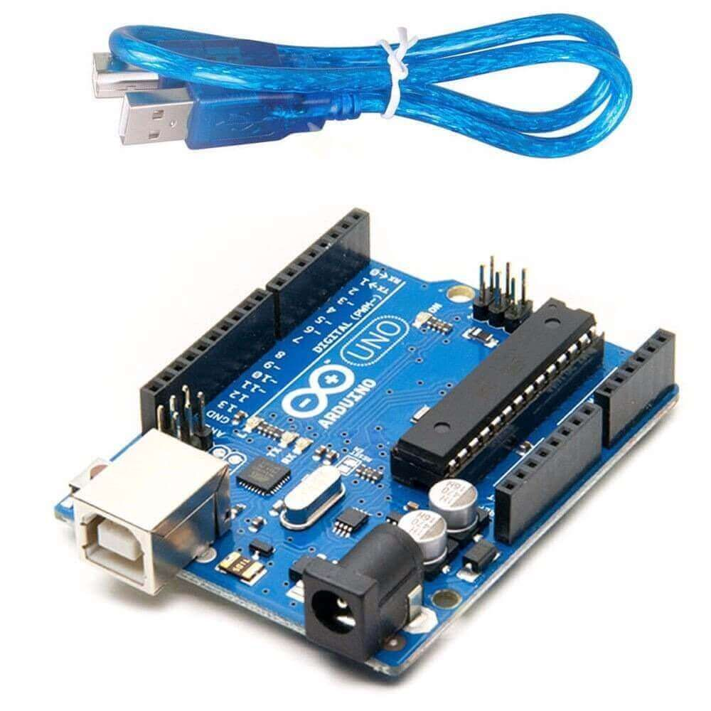
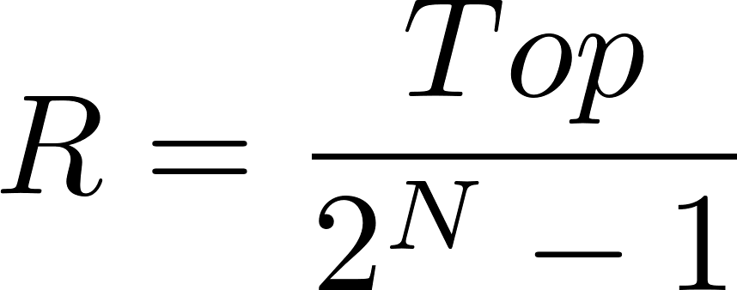
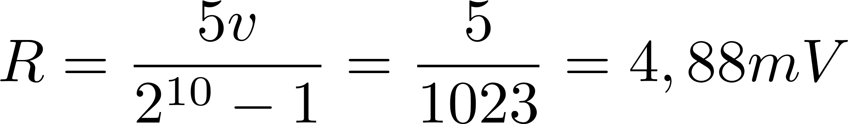
ADC RESOLUTION
R = Resolution;
N = Bits (Max)
Top = Operating Voltage
Value read by the Arduino UNO
Integer = 0 - 1023 → 0V - 5V
This means that, in the case of an Arduino Uno, the value of 0 volts in analog is expressed digitally as B0000000000 (0), and the value of 5V in analog is B1111111111 (1023). Thus, any intermediate analog value is expressed with a value between 0 and 1023; that is, 1 is added in binary for every 4.883 mV.

Slide 28
ANALOG INPUTS IN ARDUINO
Working with Arduino's analog inputs is quite simple; for this, we use the following syntax:
int variable = analogRead(pin);
The analog reading is returned as an integer variable, which is limited by the resolution of the analog-to-digital converter (0-1023 at 10 bits or 0-4095 at 12 bits).

Slide 29
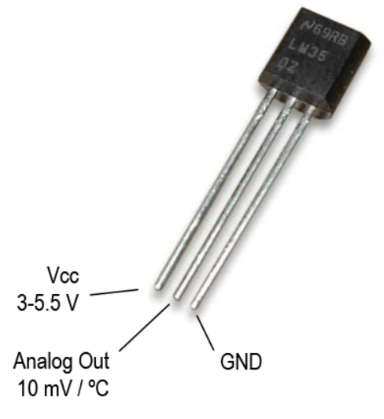
LM35 ARDUINO LCD - ADC ARDUINO
The LM35 temperature sensor offers a linear relationship in its output, increasing at a rate of 10mV per 1°C.
Its measurement range is from -55°C (-550mV) to 150°C (1500mV) with an accuracy of 0.5°C.
One of the advantages of this sensor is its low cost, which is why it has become the most widely used temperature sensor with microcontrollers.
The LM35 integrated sensor has 3 pins, where the ends are the power source, and the middle pin provides the voltage value at a rate of 10mV/°C.

Slide 30
Timers with Arduino
SERGIO ANDRES CASTAÑO GIRALDO

Slide 31

Timers com Arduino
Undoubtedly, precise time measurement in an autonomous project is of utmost importance; thus, it is essential to understand how to work with the Arduino's timers or TIMERS.
The Arduino Timer is closely related to what we explored in the last lesson, which is interruptions.

Slide 32
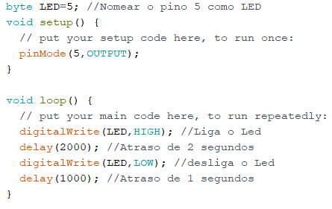

TIMERS WITH ARDUINO
The advantage of Arduino Timers is precisely that one can schedule time while simultaneously performing another task with the development board. When the pre-established time is reached, Arduino EXECUTES the interruption.

Slide 33

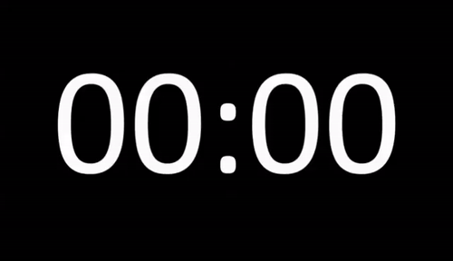


Timers
00:15
TIMER

Slide 34
Types of Timers
• Timer0: 8 bits. Used by the delay(), millis(), micros() functions. It is advisable NOT to modify this TIMER to avoid altering these functions commonly used in our codes.
• Timer1: 16 bits. Used by the Servo library in Arduino Uno (Timer5 for Arduino Mega). Mainly used for Servo control, but if you are not controlling servos, you can freely use this Arduino's Timer1.
• Timer2: 8 bits. Used in the tone() function. If you don't use this module, you can freely use Arduino's Timer2 to time another application.
• Timer3, Timer4, Timer5: Only available on Mega. All 16 bits. Primarily used for Servo control, but you are also free to use them as you see fit.

Slide 35
TimerOne Library
Currently, Arduino does NOT have an OFFICIAL library for TIMER management, as these TIMERS are used by Arduino's base functions like delay, millis, micros, servo, etc., as detailed in the previous section. Therefore, if we start modifying Timer1, for instance, we won't be able to use the Servo library, as it would present inconsistencies.

Slide 36
TimerOne Library
#include <TimerOne.h>
This will automatically create an object called Timer1 in the code, which we continue configuring with the following instructions.
Timer1.initialize (period)
This instruction initializes the timer with the period value; this value is the time we want the timer to trigger and must be written in microseconds
Timer1.attachInterrupt (ISR_Callback);
Activate the specific function that will be executed as an interruption each time the TIMER triggers. Similar to what we saw in the last post.
Timer1.detachInterrupt (ISR_Callback);
Deactivate the interruption function executed each time the TIMER is triggered.
Timer1.read ();
Read the time since the last trigger in microseconds.

Slide 37
PWM with Arduino
SERGIO ANDRES CASTAÑO GIRALDO

Slide 38
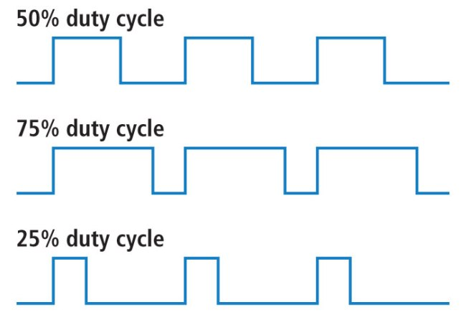
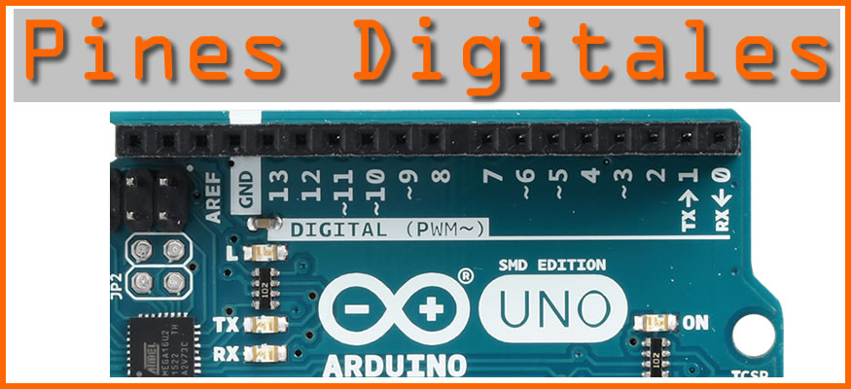
PWM with Arduino
The PWM signal with Arduino is generated on the pins marked with the symbol (~). On most commercially available Arduino boards (those with the core ATmega168 or ATmega328 microcontroller), the PWM outputs, also known as PWM Output Arduino, are located on pins 3, 5, 6, 9, 10, and 11. On the Arduino Mega, this functionality extends from pin 2 to 13 and from 44 to 46.
PINOS PWM

Slide 39
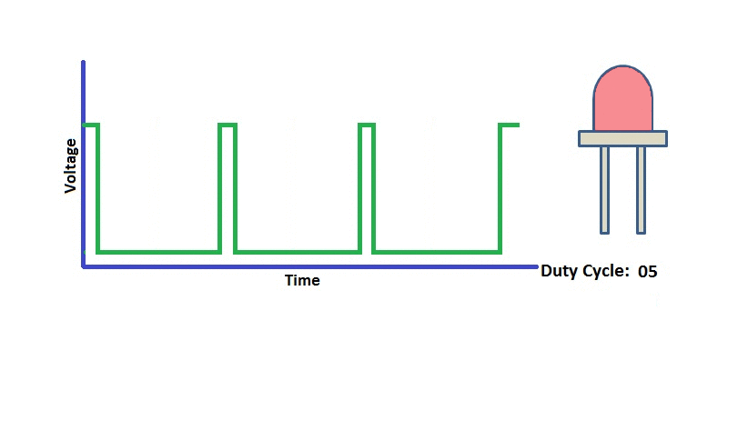
PWM with Arduino
The PWM signal with Arduino is a periodic signal (i.e., it repeats over time), and we can modify its duty cycle ("Duty Cycle" in English). This is significant because the average voltage applied to the load is proportional to the time the signal is maintained at 5V. With this capability, various applications can be realized, such as controlling the brightness of an LED (PWM Led Arduino), the speed of a motor (PWM Arduino Motor), and regulating heating resistors through solid-state relays, among others.

Slide 40
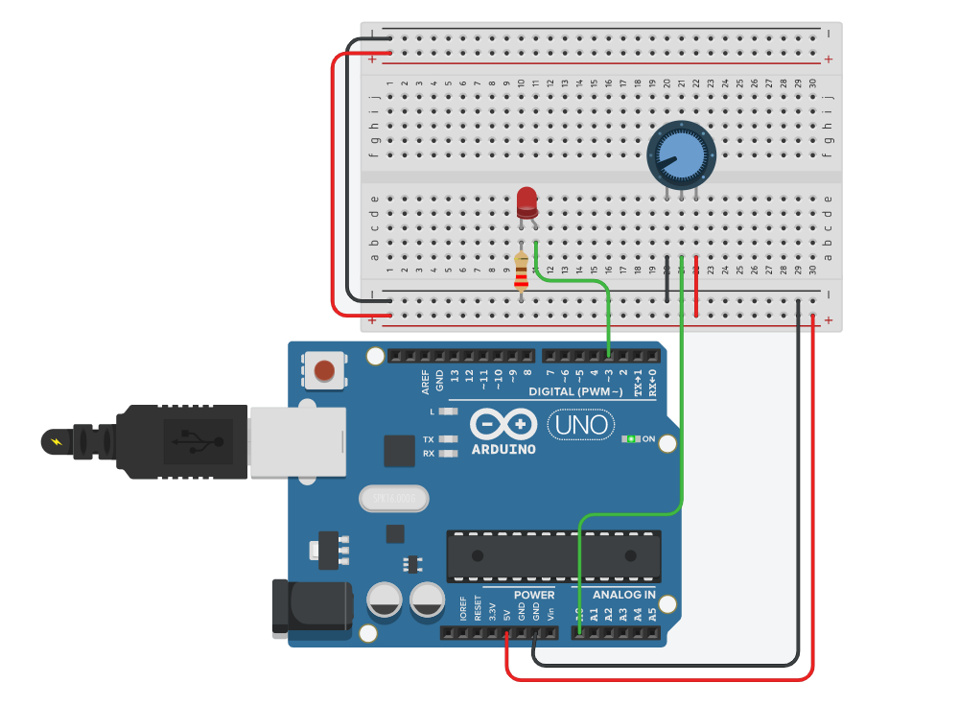
PWM LED

Slide 41
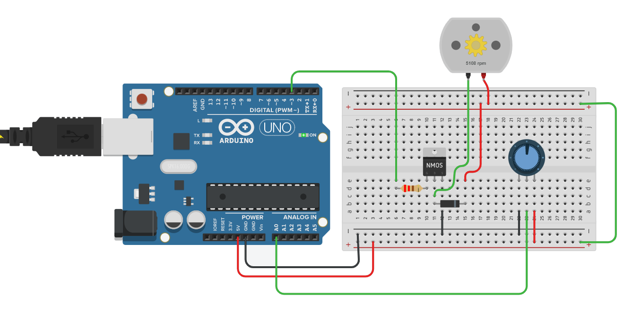
PWM DC MOTOR

Slide 42
Digital Control
Sergio Andres Castaño Giraldo

Slide 43
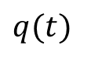
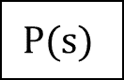
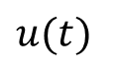





Closed Loop
$$q(t)$$
$$n(t)$$
$$r(t)$$
$$e(t)$$
$$u(t)$$
$$y(t)$$
+
$$C(s)$$
+
$$P(s)$$
+

Slide 44








Discrete Closed Loop
$$q(k)$$
$$n(k)$$
$$r(k)$$
$$e(k)$$
$$u(k)$$
$$y(k)$$
+
$$C(z)$$
+
$$P(z)$$
+

Slide 45








Discrete Closed Loop
$$q(k)$$
Sensor
$$n(k)$$
$$r(k)$$
$$e(k)$$
$$PID(z)$$
$$u(k)$$
$$y(k)$$
+
+
+
Arduino
Plant

Slide 46
Aluminum block with a heater
Differential Equation:
Euler Explicit Method:
Discretized Equation:

Slide 47
Aluminum block with a heater
// Simulation function for plant model
float simPlant(float Q, float T0) {
// Simulate a 1x1x2cm aluminum block with a heater and passive ambient cooling
float h = 5; // W/m2K, thermal convection coefficient for Al passive
float Cps = 0.89; // J/g°C, specific heat capacity of Al
float area = 1e-4; // m2, area for convection
float mass = 10; // g, mass of Al block
float Tamb = 25; // °C, ambient temperature
static float T = T0; // °C, initializing temperature of Al block
static uint32_t last = 0; // Time variable to keep track of last temperature calculation
uint32_t interval = 100; // ms, time interval for temperature calculation
// Update temperature if enough time has passed
if (millis() - last >= interval) {
last += interval;
// Update temperature
T = T + (Q * interval / 1000) / (mass * Cps) - (T - Tamb) * area * h;
}
return T; // Return updated temperature
}

Slide 48





Ziegler and Nichols
Tangent on the
inflection point
Control | $$K_{p}$$ | $$τ_{i}$$ | $$τ_{d}$$
P | $$\frac{τ}{K L}$$ | $$∞$$ | $$0$$
PI | $$0.9\frac{τ}{K L}$$ | $$\frac{L}{0.3}$$ | $$0$$
PID | $$1.2\frac{τ}{K L}$$ | $$2L$$ | $$0.5L$$

Slide 49



Ziegler Nichols

Slide 50
Ziegler Nichols

Slide 51



Ziegler Nichols

Slide 52




Ziegler and Nichols
Analog Controls and not for Digital Controls.
If the sampling period $T_{s}$​ of the system is large, the previously seen formulas may lead to a decline greater than 25%, tending towards instability.
One option is to increase the delay to a value equal to half of the sampling period
before using the values from the table
Control | $$K_{p}$$ | $$τ_{i}$$ | $$τ_{d}$$
P | $$\frac{τ}{K L}$$ | $$∞$$ | $$0$$
PI | $$0.9\frac{τ}{K L}$$ | $$\frac{L}{0.3}$$ | $$0$$
PID | $$1.2\frac{τ}{K L}$$ | $$2L$$ | $$0.5L$$

Slide 53





PID Digital
The PID discrete transfer function:

Slide 54
Global variables for PID
// Global variables for PID
double setpoint, temperature, Output = 0;
double T0 = 25.0;
float heaterWatts = 0;
float e[3] = {0, 0, 0}; // Error vector
float u[2] = {0, 0}; // Control Law vector
int kU = sizeof(u) / sizeof(float) - 1;
int kE = sizeof(e) / sizeof(float) - 1;
float kp, ti, td, q0, q1, q2; // PID Parameters
// System model parameters
float K = 1.7, tau = 150, theta = 16;
int Ts = 1; // Sampling period in seconds
float L = theta + Ts / 2;

Slide 55
Initialize PID parameters
// Initialize PID parameters (this may vary depending on the tuning)
void initializePID() {
// Ziegler–Nichols Tuning
kp = (1.2 * tau) / (K * L);
ti = 2 * L;
td = 0.5 * L;
// Discrete PID Controller
q0 = kp * (1 + Ts / (2 * ti) + td / Ts);
q1 = -kp * (1 - Ts / (2 * ti) + (2 * td) / Ts);
q2 = (kp * td) / Ts;
}

Slide 56
Control PID Digital
0
1
0
1
2
u[2]
e[3]
// Function to update past vectors
void update_past(float v[], int kT) {
int i;
for (i = 1; i <= kT; i++) {
v[i - 1] = v[i];
}
}
kT-1
kT-1
kT
kT-2
kT
PAST

Slide 57
PID Controller
// PID Controller function
float PID_Controller(float u[], float e[3], float q0, float q1, float q2)
{
float lu;
// PID Control
lu = u[0] + q0 * e[2] + q1 * e[1] + q2 * e[0]; // Discrete PID controller law
// Anti-Windup
if (lu >= 255)
lu = 255;
if (lu <= 0)
lu = 0;
return (lu);
}

Slide 58
Control Action
// SampleTime function
void SampleTime(void)
{
// Update vectors u and e
update_past(u, kU);
update_past(e, kE);
// Compute current error
e[kE] = setpoint - temperature;
// Compute PID Control Action
u[kU] = PID_Controller(u, e, q0, q1, q2);
Output = u[kU];
}

Slide 59
Moving average filter for ADC reading
// Moving average filter for ADC reading
float TemperatureFilter(float T)
{
float S1, aux;
int i;
aux = 0;
for (i = 0; i < 10; i++) {
aux = aux + T; // sensor
}
S1 = aux / 10.0;
return (S1);
}

Slide 60
setup
void setup() {
Serial.begin(9600);
initializePID(); // Initialize PID parameters
if (automatic) {
Timer1.initialize(Ts * 1000000); // Set TIMER to 8 seconds
Timer1.attachInterrupt(SampleTime); // Set up interrupt to call SampleTime
}
}

Slide 61
loop
void loop() {
static uint32_t last = 0;
uint32_t interval = 1000;
setpoint = analogRead(SETPOINT_PIN) / 4; // Read setpoint from potentiometer
if (automatic) {
heaterWatts = Output * 20.0 / 255; // 20W heater
} else {
heaterWatts = setpoint * 20.0 / 255; // 20W heater
}
temperature = TemperatureFilter(simPlant(heaterWatts, T0)); // Sensor reading
if (millis() - last >= interval) {
last += interval;
// Send data over serial port, if needed
Serial.print(setpoint);
Serial.print("\t");
Serial.print(Output);
Serial.print("\t");
Serial.print(temperature);
Serial.print("\t");
Serial.print(0);
Serial.print("\t");
Serial.println(255);
}
}

